Slide 1
Lab 10 Part
Inheritance as a Concept, Fighters

Slide 2
FighterInterface
What does FighterInterface Tell us?
What makes a Fighter?
What does a Fighter Do?
(it’s operations)

Slide 3
Operations
Get Name, Currenth_hp, Max_hp, stength, speed, magic
Causes Damage – ( getDamage() )
Take Damage – ( takeDamage() )
Reset – (reset())
Regenerate – (regenerate())
Use Special Abilities - ( useAbility() )

Slide 4

FighTer!
Name
Maximum Hit Points
Strength
Speed
Magic
*All fighters have the following attributes:
*Name - The fighter's name
*Hit Points - The amount of health the fighter has, with a specified maximum; reaching 0 is equivalent to losing
*Strength - Physical power, used to determine hit point regeneration
*Speed - Dexterity and physical movement, used to reduce damage when being attacked
*Magic - Magical prowess, used for some special abilities

Slide 5
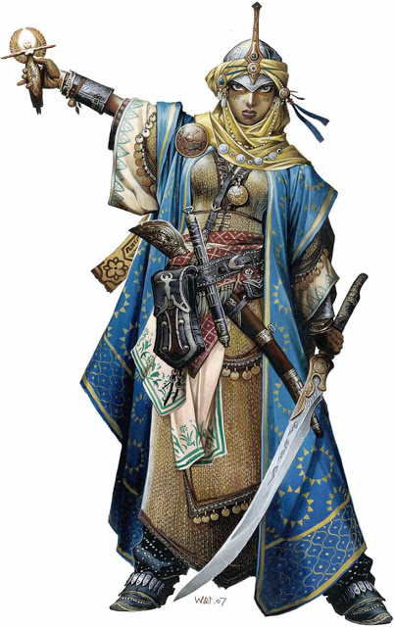


Robot Cleric Archer

Slide 6

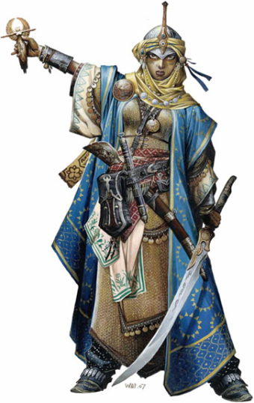


General Fighter
Name, current Hit point,
Max Hit point, Strength, Speed, and Magic

Slide 7

Robot
Extra: Energy
Damage: Strength + ( special ability)
Reset: Energy & bounus damage
Special
Ability: ShockWave Punch

Slide 8

Cleric
Extra: Mana
Damage: Magic
Reset: Mana
Regenerates: Mana
Special
Ability: Healing
Light

Slide 9

Archer
Extra: Mana
Damage: Speed
Reset: Restores current speed
Special
Ability: Quick Step

Slide 10
Let’s Create The Classes
And make them Inherit!

Slide 11
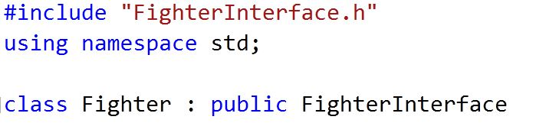
Fighter Inherits FighterInterface

Slide 12
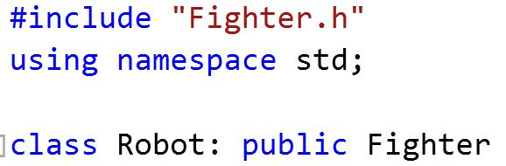
Robot ..Archer..Cleric Inherit Fighter

Slide 13
Fighter Constructor
How Should it look like?

Slide 14
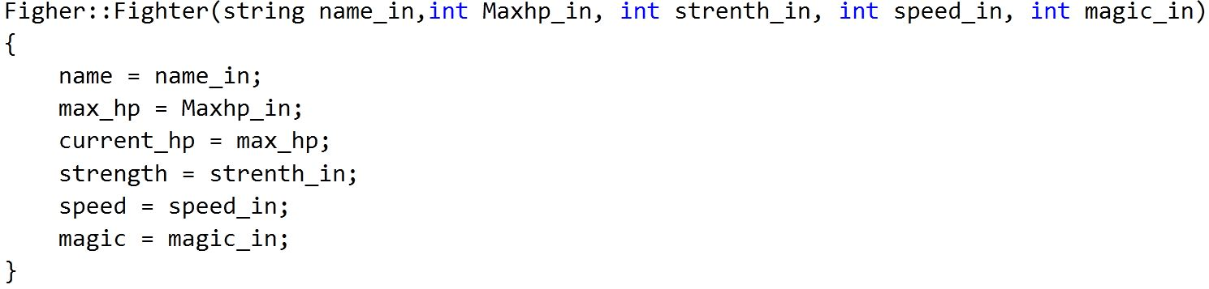
Figher.h

Slide 15
clERIC ConstrUctor
How Does That Look Like?

Slide 16
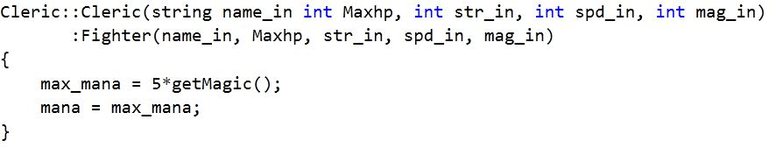
Cleric Constructor
Are Archer and Robot the Same?

Slide 17
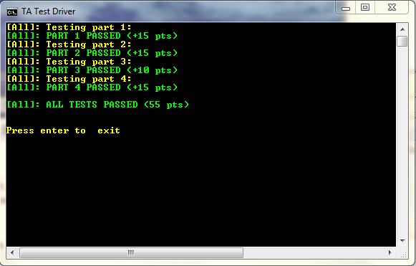
Questions?

